Slide 1
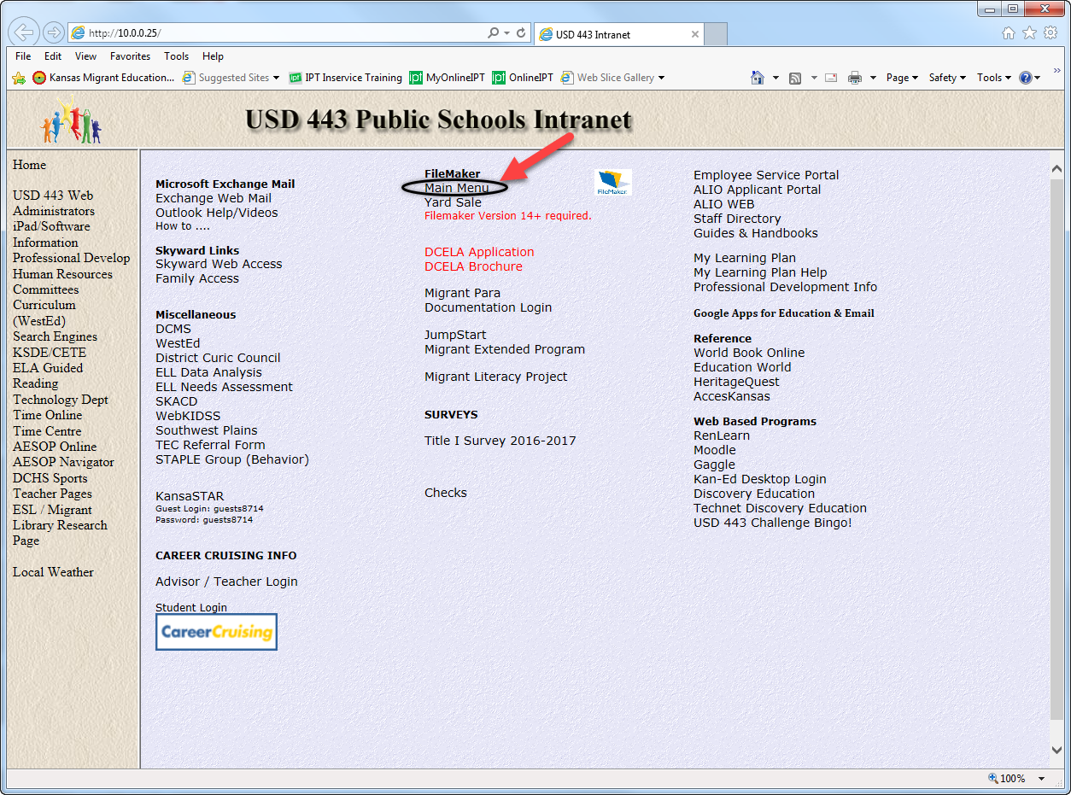
Accessing LEP Form

Slide 2
FileMaker Main Menu

Slide 3
Database

Slide 4
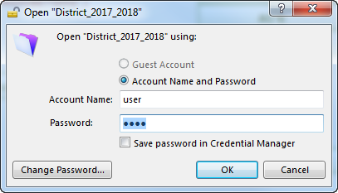
Account Name/Password

Slide 5
Data System

Slide 6
Assessments

Slide 7
ELL PLAN

Slide 8
ELL PLAN ACESS

Slide 9
LEP Form

Slide 10
Search

Slide 11
Suggestion for Parents

Slide 12
Signature

Slide 13
Next Student

