Slide 1
eWalkThrough
August 2015
The participants will demonstrate an understanding of the data collection procedure by examining the USD 443 walk through document.

Slide 2
Why an eWalkThrough?
What?
In education, we collect endless data regarding student achievement.
Often, administrators don’t know what happens in the classroom instructionally that contributes to student performance.
Southwest Plains Regional Service Center (SWPRC) has developed an electronic eWalkThrough (eWT) tool that can provide schools with this type of information.
Notes:
For example, we know how well students performed on the third grade state reading assessment.

Slide 3
What is the eWalkThrough?
The eWalkThrough is web-based.
A powerful time-saving tool that streamlines the data analysis process
Automatically creates spreadsheets and graphs from the completed classroom observations.
Allows more time to focus on instructional improvement.
Notes:
eWalkThrough Customized Tool provides:
Support for the researched-based interventions within the district’s integrated improvement plan
Common understanding of effective instruction
Identification of instructional areas of focus within the district
Data to drive differentiated professional development that results in saving the district precious resources (time/money)
A direct correlation of classroom practice to student achievement
Collective understanding instructional vocabulary
Calibration of eWalkThrough tool to ensure inter-rater reliability through professional development
Dynamic data that allows for discussion, reflection, and collaboration for instructional improvement.
Electronic reports of data with the filtering capabilities for district, building, department/grade level, teacher and more.
Instant communication capabilities through e-mail to selected personnel, such as the teacher.

Slide 4
Data Reporting
Data from the walkthroughs is immediately entered into the reports section
Data can be sorted by school and department and over specific periods of time selected by the observer.
This data can show growth that is made and the amount of growth that occurred over time.
The need for additional professional development in specific areas is identified

Slide 5
What to expect with a WalkThrough
An administrator/team will come into your room for 3-5 minutes
It is a snapshot of your instruction. They will not see everything.
The administrator/team will have their iPads to collect data.
The eWalkThrough document is a self-reflection tool for teachers.
It is NOT an evaluation or tied to it in any way.

Slide 6
The Power of Feedback
The immediate feedback that teachers are provided is extremely powerful.
Each eWalkThrough is saved by the observer
The teacher immediately receives a copy of the completed walkthrough.
The self-reflection opportunity is provided to the teacher.
Teachers can immediately begin to reflect and plan for change.

Slide 7
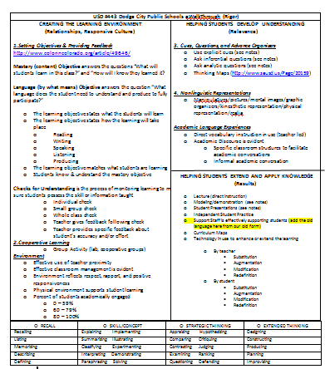
The eWalkThrough Document

Slide 8
Creating the Learning Environment...
With your partner discuss. . .
*What is needed in a mastery objective?
-A Mastery Objective should answer the questions “What do I want students to learn today? and How will I know they learned it?”
-The Language Objective will address the language skills (reading/writing/speaking/listening) that students will need to be successful in the mastery objective.

Slide 9
Creating the Learning Environment...
With your partner discuss. . .
*What is a check for understanding?
-an activity that checks students understanding of a concept used to adjust instruction and monitor learning.
* Describe to your partner a check for understanding that works well for you. Then, share with the group.

Slide 10
Creating the Learning Environment...
With your partner discuss. . .
*What does an effective learning environment look like??
-An effective learning environment supports student learning through the use of groups, teacher proximity, effective classroom management, respect, and rapport.
*What does an effective learning environment look like? sound like?

Slide 11
Instructional Strategies...
1) Cues, Questions, Graphic Organizers & Non-Linguistic Representations
These instructional strategies will be looked at more closely throughout this year.
2) Academic Discourse Opportunities
Are students talking? Are they using specific academic language?
3) Technology SAMR
Who is using the technology and how is it being used?

Slide 12
Depth of Knowledge / Blooms...
DOK 1: RECALL
recalling, listing, memorizing, describing, defining
DOK 2: SKILL / CONCEPT
explaining, summarizing, classifying, illustrating, experimenting
DOK 3: STRATEGIC THINKING
comparing, questioning, judging, ranking, defending, appraising
DOK 4: EXTENDED THINKING
designing, constructing, producing, planning, improvising

Slide 13
Team Goal Setting...
Set one Team Goal During Team Time and two Personal Goals.
Examples:
-Students will know & understand the mastery objective 75% of the walkthroughs.
-More than 60% of the students will be academically engaged 80% of the walkthroughs.
-My class will be marked in DOK level 2 or higher 50% of the walkthroughs.
-Students will be using technology on 40% of the walkthroughs.

Slide 14
Additional Info...
Administrators: WalkThroughs in our building. Add/Clarify for better understanding.

